Slide 1
A Presentation On Campus Management System
Guided by:
Miss. Shalini Kumari. Technical trainer.
Presented By:
Miss. Khushbu Bandewar
Miss. Ankita Dohale
Java Full-Stack Development
EduBridge

Slide 2
Content
Introduction
Motivation
Objectives
Problem Definition
Software Requirement
Output
Advantages
Conclusion

Slide 3
Introduction
This Placement Management System is provides information about jobs for beginner and experienced to related there Profession.
This system is specially helpful for student or any people . Who need to information about jobs in any profession .

Slide 4
Motivation
To reduce manual work.
To maintain the various jobs activities related every Profession.

Slide 5
Objective
To study different Front-End and Back-End website.
To compare the proposed with existing system.
To develop a creative and logical thinking.
Improve the practical Knowledge In front-end and back-End.

Slide 6
Problem of definition
This website is create for helping of many student as well as experience people for applying jobs or knowing the information
In this system we Provide our services so first user can registration on that if they are already register then they can login and visit to our website.

Slide 7
Software Requirement
Front end :
HTML
CSS
JavaScript.
Java
IDE :
Sprint tool suite.

Slide 8
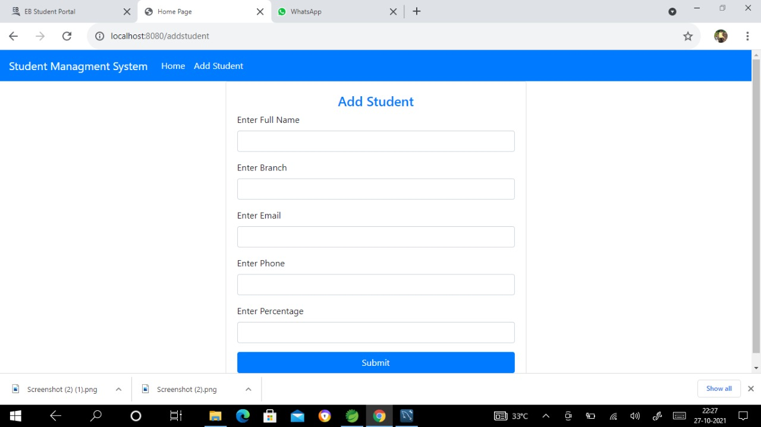
Outputs

Slide 9
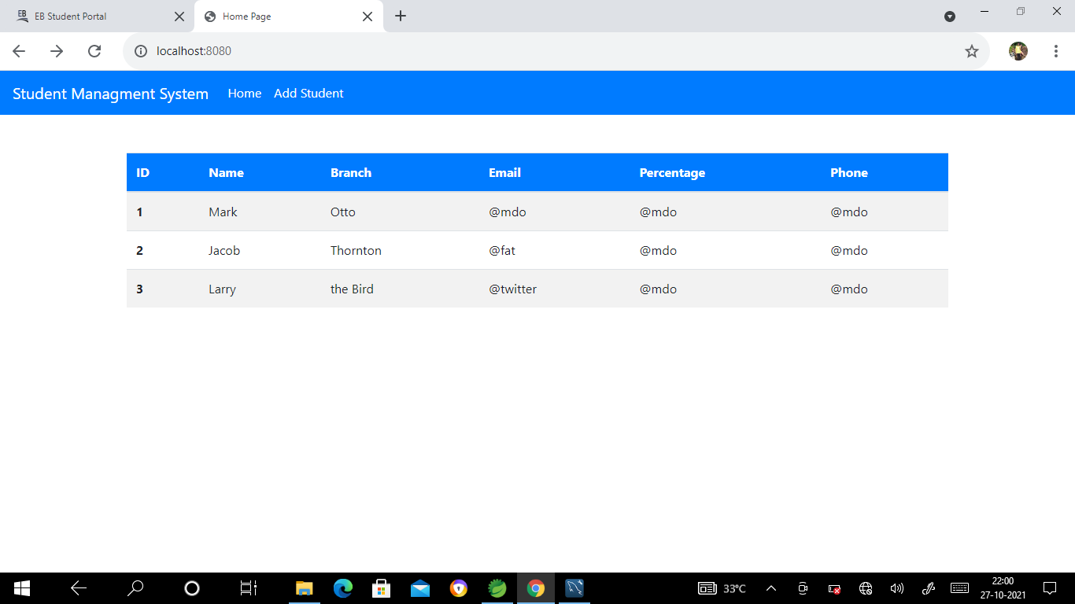
Outputs

Slide 10
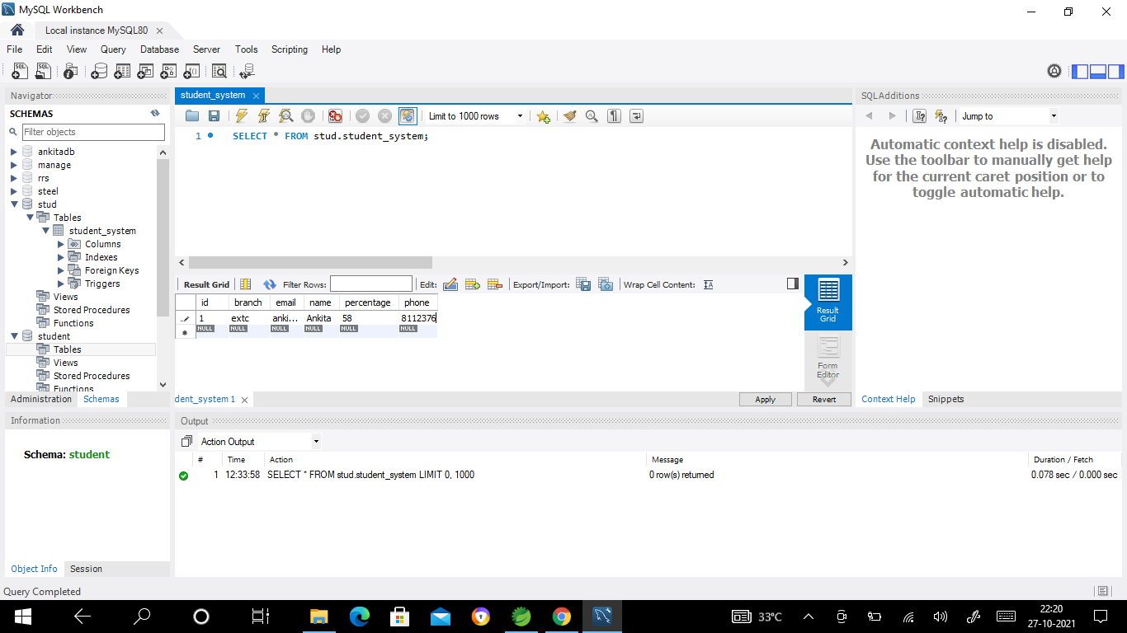
Outputs

Slide 11
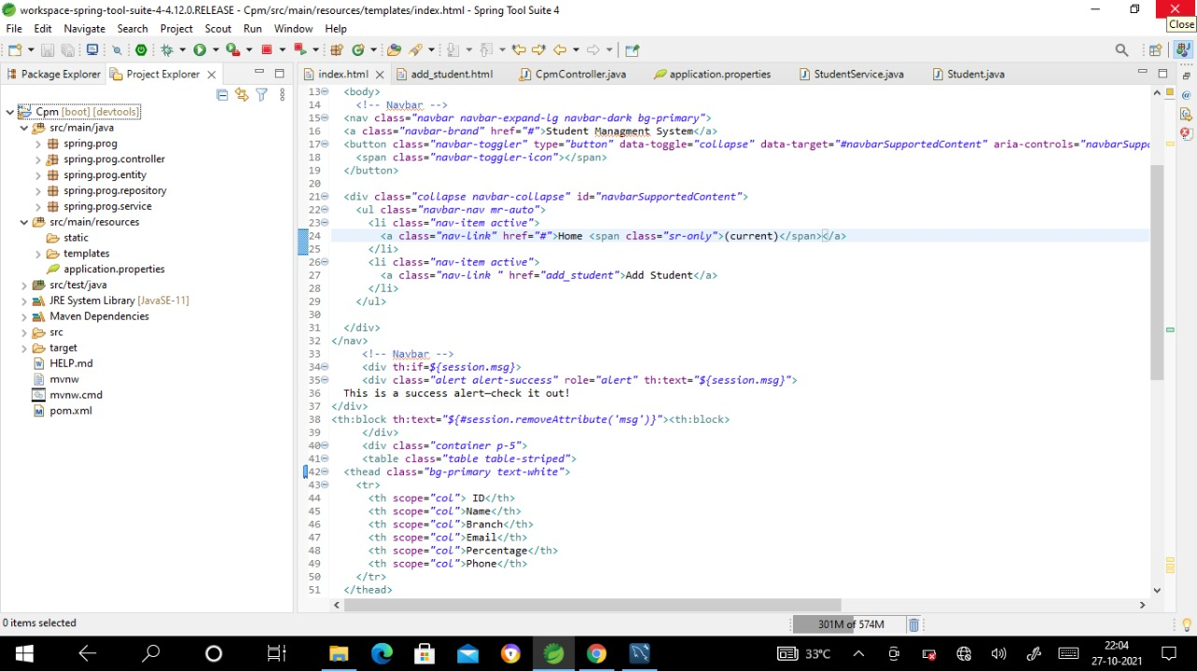
Outputs

Slide 12
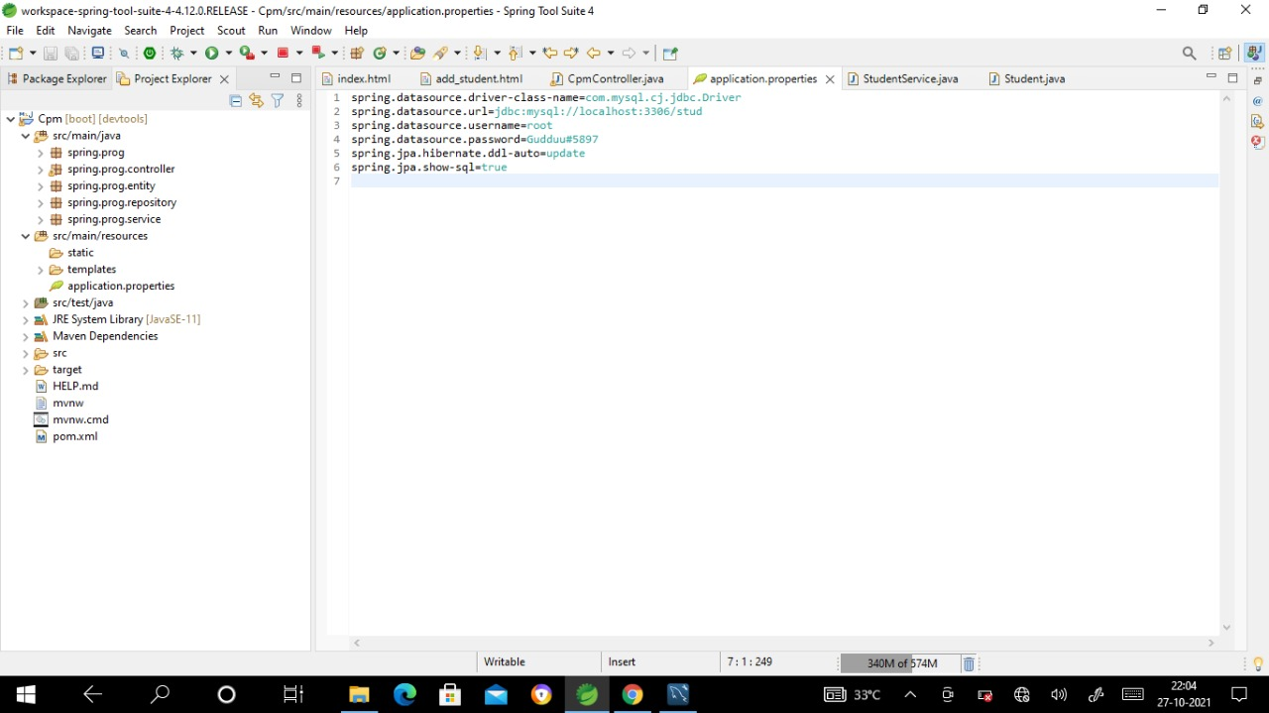
Outputs

Slide 13
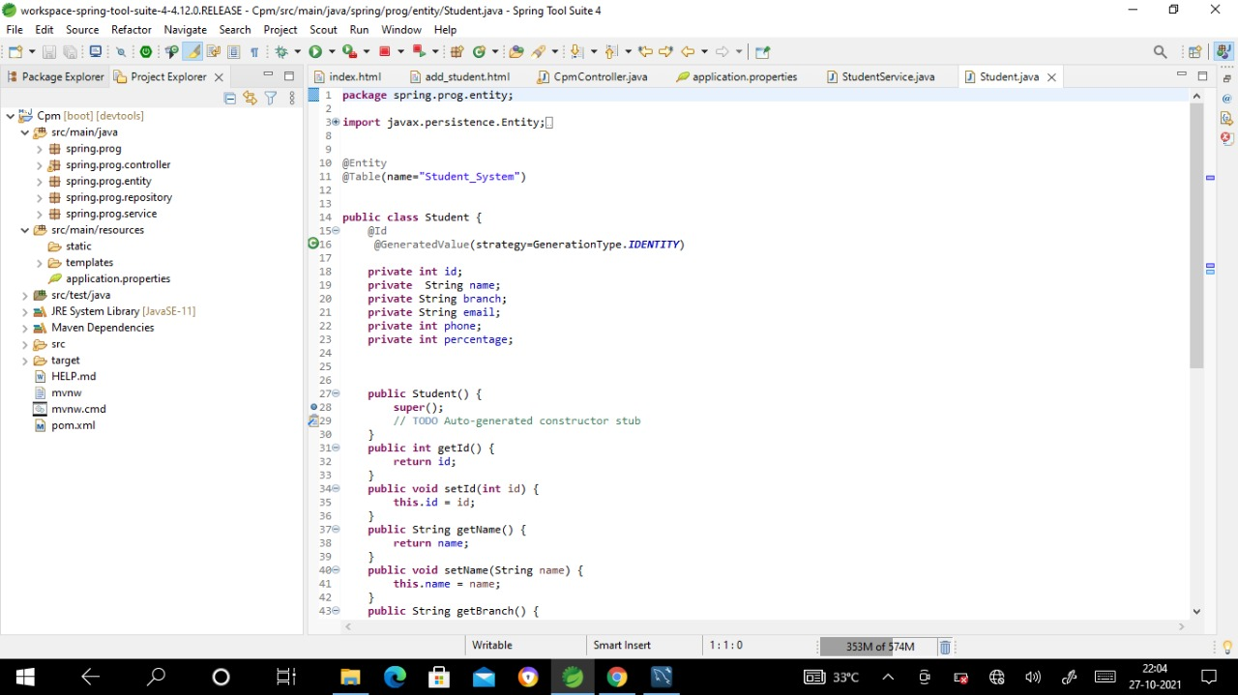
Outputs

Slide 14
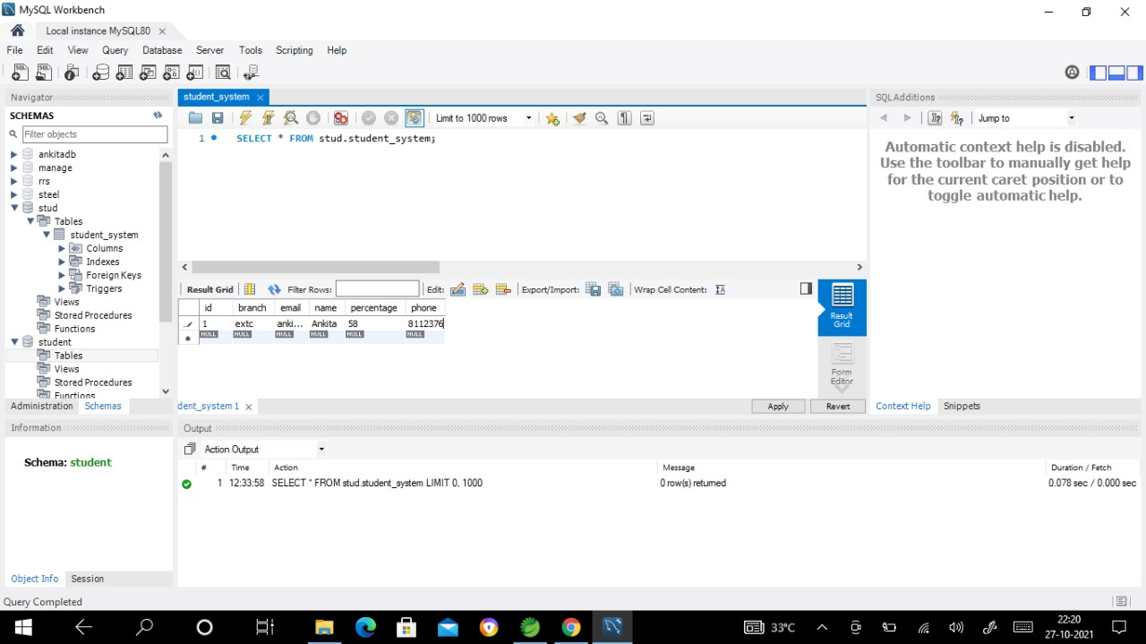
Outputs

Slide 15
Conclusion
This application provide all the necessary details or information about related to jobs for as a fresher(beginner) or a professional one they can easily find there requirements in this application.

Slide 16
Future Scope
Provide more Attractive look and many more features according to user requirements or needs.

